Slide 1
European Day of Languages (September, 26)

Slide 2
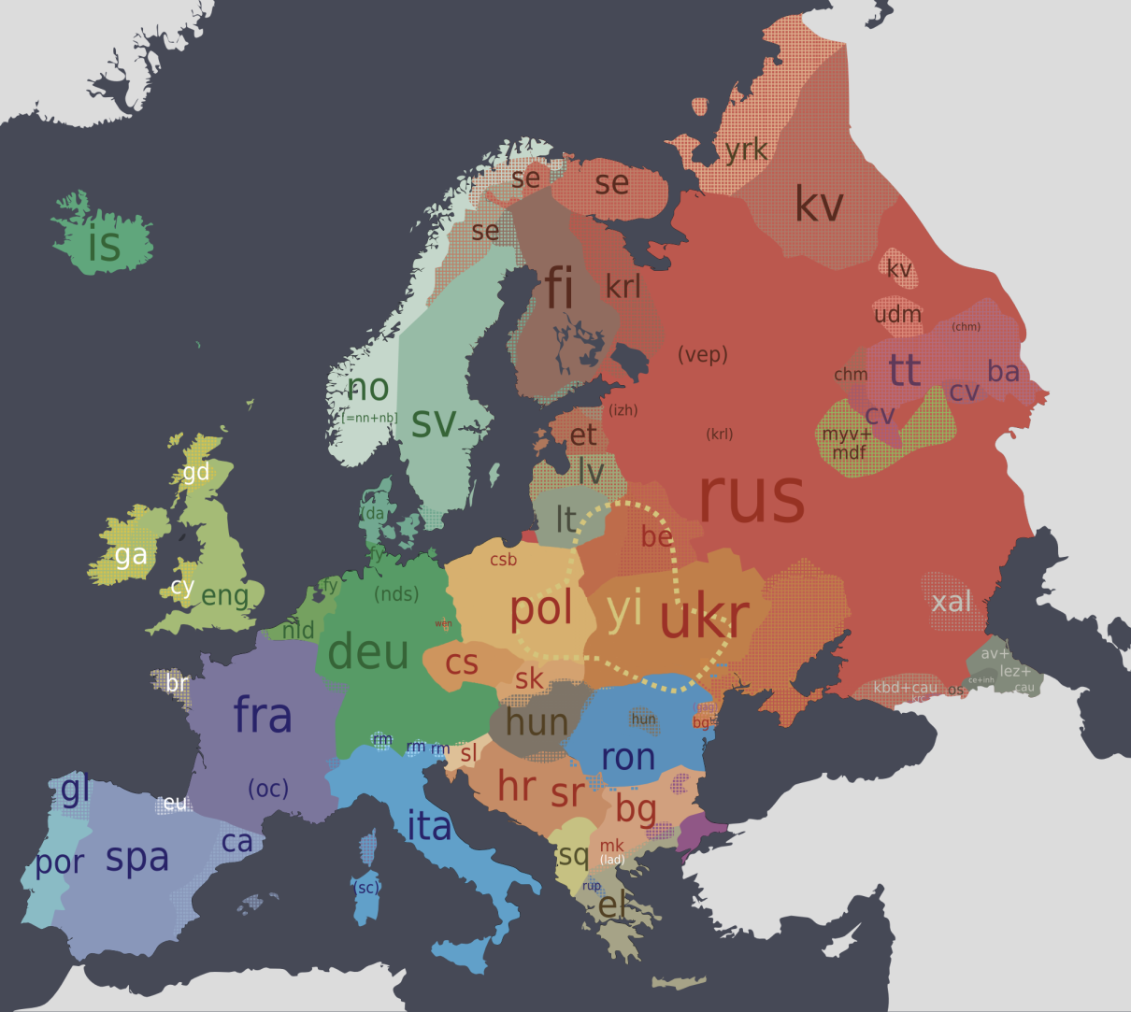
The European Day of Languages is 26th September, as proclaimed by the Council of Europe on 6th December 2001, at the end of the European Year of Languages (2001), which had been jointly organized by the Council of Europe and the European Union. Its aim is to encourage language learning across Europe.

Slide 3
Objectives :
The general objectives of the European Day of Languages are to:
alert the public to the importance of language learning and diversify the range of languages learned in order to increase multilingualism and intercultural understanding;
promote the rich linguistic and cultural diversity of Europe;
encourage lifelong language learning in and out of school.

Slide 4
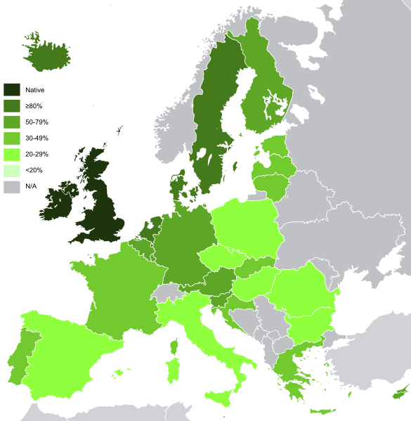
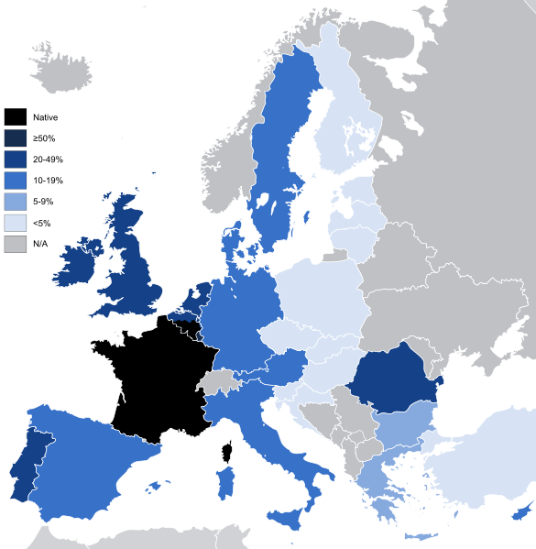
Languages of Europe
There are about 225 indigenous languages in Europe. Most of the European languages are of Indo-European origin.

Slide 5
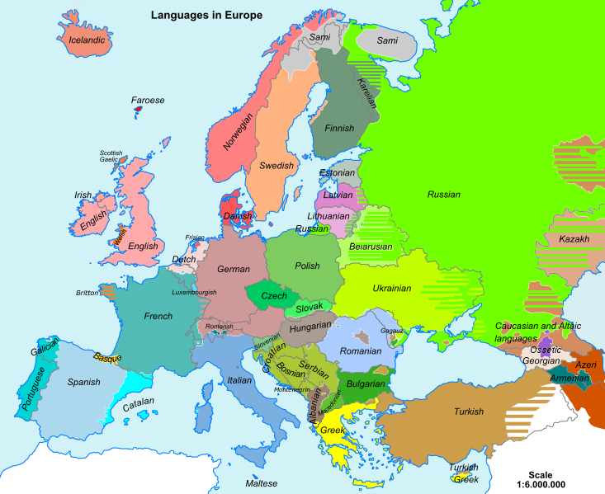
Indo-European language family is divided into a number of branches, including Romance, Germanic, Baltic, Slavic, Albanian and Greek.

Slide 6
English is currently the most popular foreign language in Europe, followed by German, French, Italian, Russian and Spanish
One of the smallest languages in Europe is Maltese (the national language of Malta)

Slide 7
Thank you!

